Slide 1
NP-completeness 3-colorability
Emanuele Viola

Slide 2
Definition: A 3-coloring of a graph is a coloring of each node, using at most 3 colors,
●
such that no adjacent nodes have the same color.
●
Example:
a 3-coloring
not a 3-coloring

Slide 3
Definition:
●
3COLOR = {G | G is a graph with a 3-coloring}
●
Example:
G =
G ?? 3COLOR

Slide 4
Definition:
●
3COLOR = {G | G is a graph with a 3-coloring}
●
Example:
G =
H =
G ∈ 3COLOR
H ? 3COLOR

Slide 5
Definition:
●
3COLOR = {G | G is a graph with a 3-coloring}
●
Example:
G =
H =
G ∈ 3COLOR
H ∉ 3COLOR
(> 3 nodes, all connected)
Conjecture: 3COLOR ∉P

Slide 6
Theorem: 3COLOR ∈P ⇨3SAT ∈P
Proof outline:
Give algorithm R that on input φ :
(1) Computes a graph G such that
φ
φ ∈3SAT G_{φ} ∈3COLOR.
(2) R runs in polynomial time
Enough to prove the theorem ?

Slide 7
Theorem: 3COLOR ∈P ⇨3SAT ∈P
Proof outline:
Give algorithm R that on input φ :
(1) Computes a graph G such that
φ
φ ∈3SAT G_{φ} ∈3COLOR.
(2) R runs in polynomial time
Enough to prove the theorem because:
If algorithm C that solves 3COLOR in polynomial-time Then C( R( φ ) ) solves 3SAT in polynomial-time

Slide 8
Theorem: 3COLOR ∈P ⇨3SAT ∈P
Definition of R:
“On input φ, construct G_{φ} as follows:
Add 3 special nodes
F
T = “true” F = “false” B = “base”
called the “palette”.
T B
For each variable, add 2 literal nodes.
x
¬x
For each clause, add 6 clause nodes.

Slide 9
Theorem: 3COLOR ∈P ⇨3SAT ∈P
Definition of R (continued):
F
For each variable x, connect:
T
B
x
¬x
For each clause (a V b V c), connect:
F
T B
End of definition of R.
a
b
c

Slide 10
φ = (x V y V z) Λ (¬x V ¬y V z)
Example:
G_{φ}=
F
T
B
x
¬x
y
¬y
z
¬z

Slide 11
Claim: φ ∈3SAT G_{φ} ∈3COLOR
Before proving the claim, we make some remarks, and prove a fact that will be useful

Slide 12
Remark
Idea: T's color represents TRUE F's color represents FALSE
F
In a 3-coloring, all variable nodes must be colored T or F because?
T
B
x
¬x

Slide 13
Remark
Idea: T's color represents TRUE F's color represents FALSE
F
In a 3-coloring, all variable nodes must be colored T or F because connected to B.
T
B
x
¬x
Also, x and ¬x must have different colors because?

Slide 14
Remark
Idea: T's color represents TRUE F's color represents FALSE
F
In a 3-coloring, all variable nodes must be colored T or F because connected to B.
T
B
x
¬x
Also, x and ¬x must have different colors because they are connected.
So we can “translate” a 3-coloring of G_{φ}
into a true/false assignment to variables of φ

Slide 15
Fact: Graph below 3-colorable a, b, or c colored T
The idea is simply that each triangle computes “Or”
F
T
B
a
b
c

Slide 16
Fact: Graph below 3-colorable a, b, or c colored T
Proof of ⇨: Suppose by contradiction that
a, b, and c are all colored F then P colored how?
F
T
B
P
a
b
c

Slide 17
Fact: Graph below 3-colorable a, b, or c colored T
Proof of ⇨: Suppose by contradiction that
a, b, and c are all colored F then P colored F. Then Q colored how?
Q
F
T
B
P
a
b
c

Slide 18
Fact: Graph below 3-colorable a, b, or c colored T
Proof of ⇨: Suppose by contradiction that
a, b, and c are all colored F then P colored F. Then Q colored F. But this is not a valid 3-coloring
Done
Q
F
T
B
P
a
b
c

Slide 19
Fact: Graph below 3-colorable  a, b, or c colored T
Proof of ⇦: We show a 3-coloring for each way in which a, b, and c may be colored
F
T
B
a
b
c

Slide 20
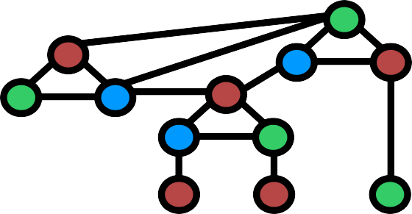
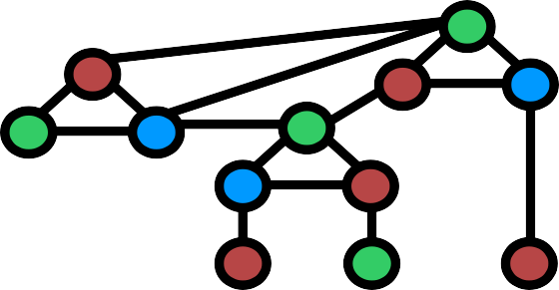
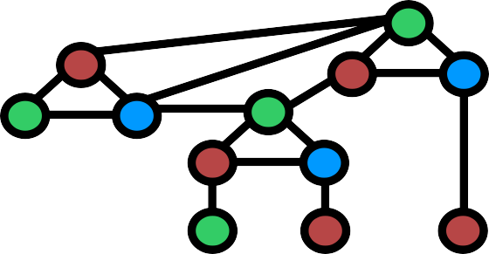
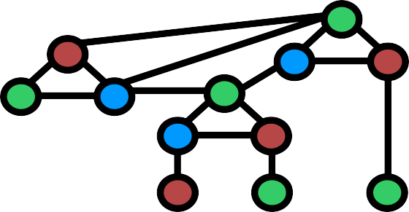
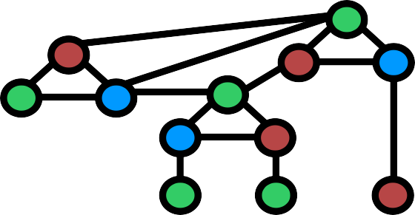
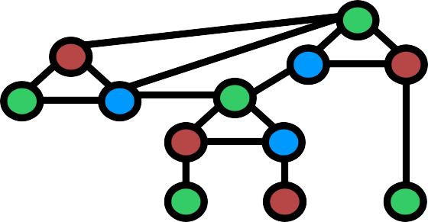
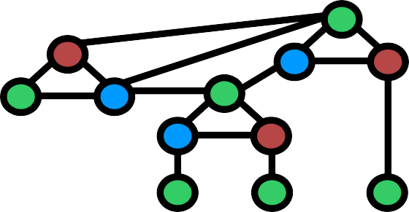
Fact: Graph below 3-colorable a, b, or c colored T
Proof of ⇦: We show a 3-coloring for each way in which a, b, and c may be colored
Done

Slide 21
Claim: φ ∈3SAT G_{φ} ∈3COLOR
Proof: ⇨
Color palette nodes green, red, blue: T, F, B.
Suppose φ has satisfying assignment.
Color literal nodes T or F accordingly F
Ok because ?
T
B
x
¬x

Slide 22
Claim: φ ∈3SAT G_{φ} ∈3COLOR
Proof: ⇨
Color palette nodes green, red, blue: T, F, B.
Suppose φ has satisfying assignment.
Color literal nodes T or F accordingly Ok because they don't touch
T or F in palette, and x and ¬ x are given different colors
F
T
B
x
¬x
Color clause nodes using previous Fact. Ok because?

Slide 23
Claim: φ ∈3SAT G_{φ} ∈3COLOR
Proof: ⇨
Color palette nodes green, red, blue: T, F, B.
Suppose φ has satisfying assignment.
Color literal nodes T or F accordingly Ok because they don't touch
T or F in palette, and x and ¬ x are given different colors
F
T
B
x
¬x
Color clause nodes using previous Fact.
Ok because each clause has some true literal

Slide 24
Claim: φ ∈3SAT G_{φ} ∈3COLOR
Proof: ⇦
Suppose G_{φ} has a 3-coloring
Assign all variables to true or false accordingly. This is a valid assignment because?

Slide 25
Claim: φ ∈3SAT G_{φ} ∈3COLOR
Proof: ⇦
Suppose G_{φ} has a 3-coloring
Assign all variables to true or false accordingly. This is a valid assignment because by Remark, x and ¬x are colored T or F and don't conflict.
This gives some true literal per clause because?

Slide 26
Claim: φ ∈3SAT G_{φ} ∈3COLOR
Proof: ⇦
Suppose G_{φ} has a 3-coloring
Assign all variables to true or false accordingly. This is a valid assignment because by Remark, x and ¬x are colored T or F and don't conflict.
This gives some true literal per clause because clause is colored correctly, and by previous Fact
All clauses are satisfied, so φ is satisfied.

Slide 27
Example: φ = (x V y V z) Λ (¬x V ¬y V z)
Satisfying assignment: x = 0, y = 0, z = 1
G_{φ}=
F
T
B
B
x
¬x
y
¬y
z
¬z

Slide 28
It remains to argue that R runs in polynomial time
To add variable nodes and edges, cycle over v ≤ | φ | variables
To add clause nodes and edges, cycle over c ≤ | φ | clauses
Overall, ≤ | φ | + | φ |,
which is polynomial in input length | φ |
End of proof that 3COLOR ∈P ⇨3SAT ∈P

